Slide 1
Fiscal risks and climate change
Outline
March 2024

Slide 2
Content
Evaluating fiscal risks
  What can we learn from literature?
  What are some of the main strengths and weaknesses of current approaches?
  Way forward: a comprehensive framework for fiscal risks assessment
Reviewing climate risks
Integrating climate risks into fiscal risk assessment
Identifying fiscal policy tools to address fiscal risks stemming from climate change

Slide 3
I. Evaluating fiscal risks a. What we learn from literature?

Slide 4
Fiscal Risks
“Risk” is uncertainty of outcomes caused by future events.
We compose risk into four components: hazard, exposure, sensitivity, and coping capacity.
Similar Hazards pose risks to flows (taxes and spending) and to stocks (government assets and liabilities)
Risks to flows of revenue and expenditures
  Higher than anticipated outflows (expenditures)
  Lower than anticipated inflows (revenues)
Risk to assets
  On the asset side risks may erode the value of accumulated assets and their associated inflows
  On the liability side, risks affect direct as well as contingent external debt
Risks often feed each other, delivering powerful pro-cyclical blow to the government balance sheet.

Slide 5
Risk: Financial Example
Value at Risk (VAR) at a particular probability scenario over timescale (1 year) includes hazard , exposure and sensitivity. In a linear situation (rare):
VAR_{95%} = Move_{95%} * Exposure * Sensitivity
We compose risk into four components: hazard, exposure, sensitivity, and coping capacity.
To use a financial example, Risk can be composed into
  Hazard to a bank might be the potential 95% worst-case move of long term USD interest rates,
  Exposure might be the value of US gov bonds held
  Sensitivity is the change of value of the bonds to the interest rate
  Overall coping capacity might be the capital buffer of the bank.
Risk | Hazard | Exposure | Sensitivity | General Coping Capacity
Risk bank goes bankrupt measured by credit rating of the bank | Hazard 1 (Market Risk) Change in USD long term interest rates (r, %) | USD gov bonds held ($m) | Raw sensitivity Change in value per 1% change in r per $ exposure | Capital buffer ($m)

Slide 6
Measuring Hazards
Hazards are the risk of some shock in a reference variable
For example a shock might be in temperature
Hazards are probabilistic, we are interested not just in the mean outcome but also the variability and the reasonable worst case
Climate-related natural hazards are likely to increase
There are different approaches to measuring the possible cases for a given variable: from the quantitative (historical simulation or modelling based on probability distribution) to the more scenario based.
Scenarios may or may not have a defined probability of occurring.
‘Reasonable worst case’ could mean
  a one-in-twenty year event
  a one-in-one hundred year event or
  the most likely (median) outcome given optimism bias.
Beware of biases in quantitative evaluation! Accounting for model error/uncertainty/change, chances may be higher than estimated, so a 1-in-100 event (based on historical frequencies or mode) may actually occur more often

Slide 7
World Bank’s Fiscal Risks Toolkit
Fiscal Risks Matrix helps identify which fiscal risks are large, how their size can be affected so as to begin to design fiscal risk mitigations strategies, and reform measures to minimize these risks.
P-FRAM Model – PPP-Fiscal Risks Assessment Model were applied to three sample projects supplied by MoF. Identify cash flow and actuarial effects as well as a “Heat Map” of various fiscal risks the project faces on the basis of these PPP contracts (at national and sub-national levels)
Stochastic Fiscal Sustainability Assessment – that looks at aggregation of these fiscal risks in a probabilistic and endogenous analytical framework. Generates “Fan Charts” and cumulative probability distributions of key variables (such as Debt/GDP ratio).
Note: The above description of WBG fiscal risks toolkit is based on training modules by Shan Gooptu.

Slide 8
Government Fiscal Hedge Matrix
(Assets and Contingent Financing)
SOURCES of Financial Safety | DIRECT (based on the stock of existing assets) | CONTINGENT (dependent on future events, such as value generated in the future)
EXPLICIT (based on government legal powers such as ownership, right to raise taxes and other revenues.) | Asset recovery (workouts, sales of non-performing loans, state equity sales, etc.) Proceeds from privatization of state-owned enterprises (SOEs) and other public resources. Recovery of government loan assets (e.g. resulting from earlier direct government lending.) | Government Revenues from natural resource extraction and sales. Government customs revenues Tax Revenues less: Tax Expenditures Revenues from forward sales (e.g. commodity forward sales) Hedging instruments and re-insurance purchased by government.
IMPLICIT (based on Government indirect control) | Stabilization and Contingency funds.* Positive net worth of Central Bank. | Profits of state-owned enterprises Contingent credit lines and financing commitments from IFIs. Current account surpluses across currencies.
Source: Polackova-Brixi, Hana and Alan Schick (1998), Government at Risk, World Bank. p. 26.
Note: * Can be designed as general or specific purpose funds under direct or indirect control of government.
Notes:
Tax Expenditures include: exclusions, exemptions, and deductions, which reduce taxable income.

Slide 9
PPPs and Fiscal Management
Assessing affordability and managing fiscal commitments
Assessing
project efficiency and
PPP mechanisms
Limiting
moral hazard
Fiscal costs & fiscal risks from each project
Aggregate risks and fiscal stability
Fiscal rules
Accounting standards
Reporting procedures
Cost & benefit analysis
PPP vs non-PPP
Which type of PPP
Bankability / fin. cost
Long-term robustness
DSA and MTBF: include potential costs to the budget of all PPP contracts
Full disclosure: budgetary costs of PPP contracts over time; obligations borne by government and by SOEs

Slide 10
World Bank’s Fiscal Sustainability Analysis
Addresses volatility and uncertainty surrounding oil prices and growth
Stochastic DSA which incorporates past co-movements in:
      Oil/commodity prices, REER, RIR, output growth
Helps to set out a probabilistic path of government debt
Allows for comparison of realization of various contingent liabilities vs. reform scenarios in a world with uncertainty.
Supplements other fiscal risk assessment tools in WBG Toolkit: The “Fiscal Risks Matrix”, the WB-IMF PFRAM, PROST model for pensions, among others.

Slide 11
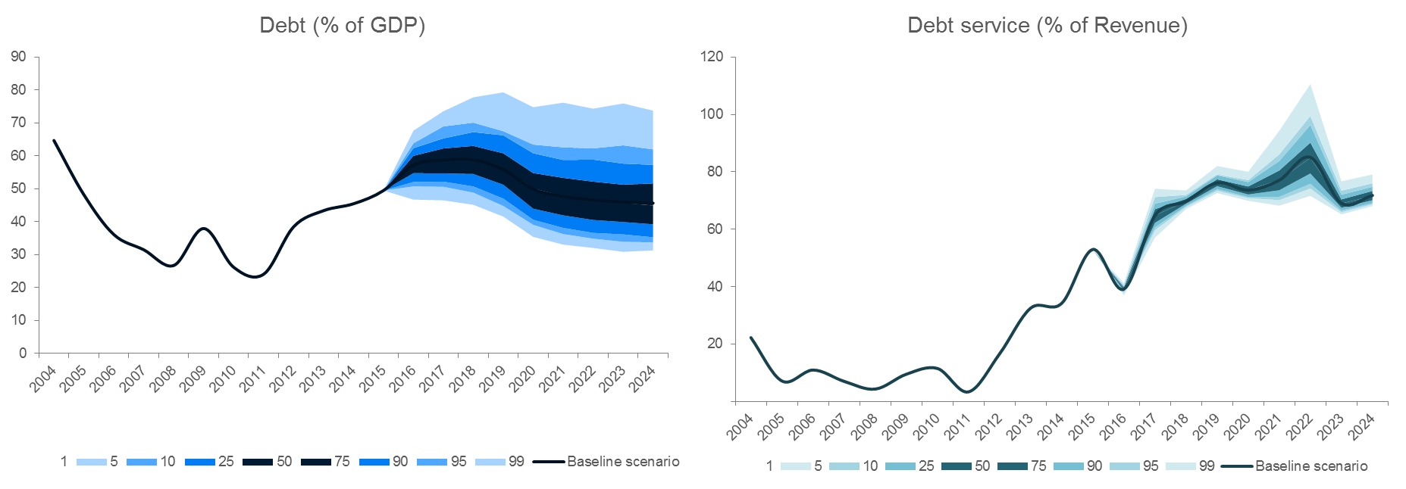
Case Study: Application to Country Infrastructure PPPs
Stochastic Fiscal Sustainability Assessment – looks at aggregation of these fiscal risks in a probabilistic and endogenous analytical framework.
Generates “Fan Charts” and cumulative probability distributions of key variables (such as Debt/GDP ratio).

Slide 12
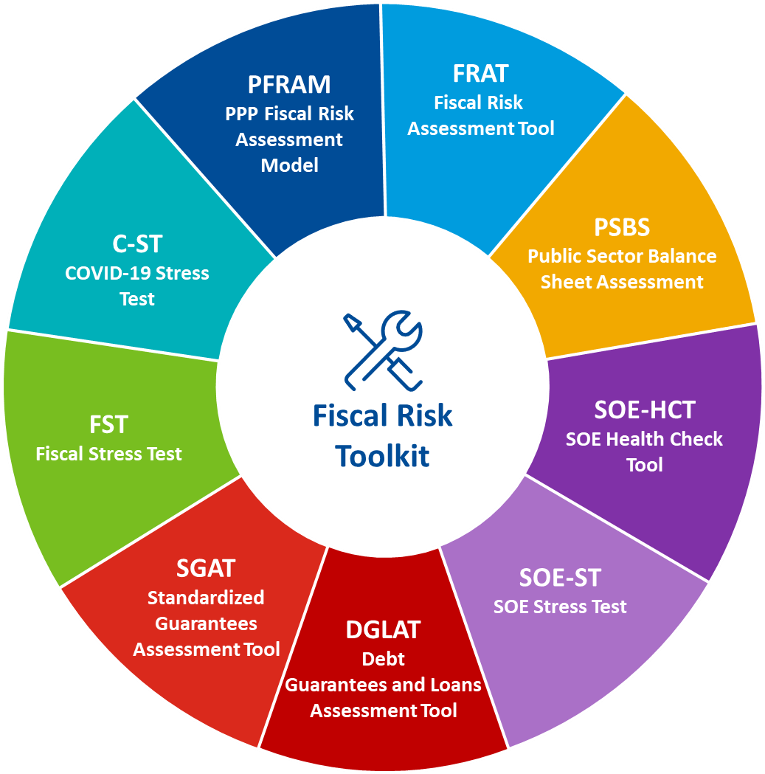
IMF’s Fiscal Risk Assessment Tool (FRAT)
Provides a qualitative identification of fiscal risks complemented by some quantitative analysis.
Offers a high-level portfolio perspective on a wide spectrum of 14 fiscal risks, covering macroeconomic, specific, and institutional risks.
Provides outputs on risk-by-risk level, portfolio level (e.g., historical risk realizations, information and data gaps, impact-likelihood matrix, risk mitigation, macro-fiscal forecast error analysis, time series analysis), and international comparisons (along 24 indicators).

Slide 13
Other approaches
OECD/Academia?

Slide 14
I. Evaluating fiscal risks b. Critique

Slide 16
I. Evaluating fiscal risks c. A comprehensive framework for fiscal risks assessment

Slide 17
IMF: Assessing adaptation spending on debt sustainability
DIGNAD model (Debt-Investment-Growth and Natural Disasters) toolkit enables macro policy assessments of building resilience to and recovery from natural disasters in EMDEs
Advantages:
  Open-source
  Accessible frontend
  Can be parametrized relatively easily
  Goes beyond previous DSF approaches to climate change expenditures in considering effects of deficit-financed adaptation spending for both the numerator and denominator of debt income ratios.
  Effectiveness of public spending is considered endogenous to PFM reforms, and one can link to different scenarios for concessional finance.
Areas for further work: providing guidance to teams how to parametrize the model, grounding the parameters in empirical assessments

Slide 18
II. Identifying climate risks to be added

Slide 19
Climate Risks
Climate change brings forth two major categories of risks: physical (acute and chronic) and transition, affecting various sectors and economies diversely.
Physical risks encompass sudden natural disasters and gradual impacts, directly impacting infrastructure, productivity, and economic activity.
Transition risks arise from the shift towards a low-carbon economy due to policy changes, technological advancements, or market shifts, affecting asset valuations

Slide 20
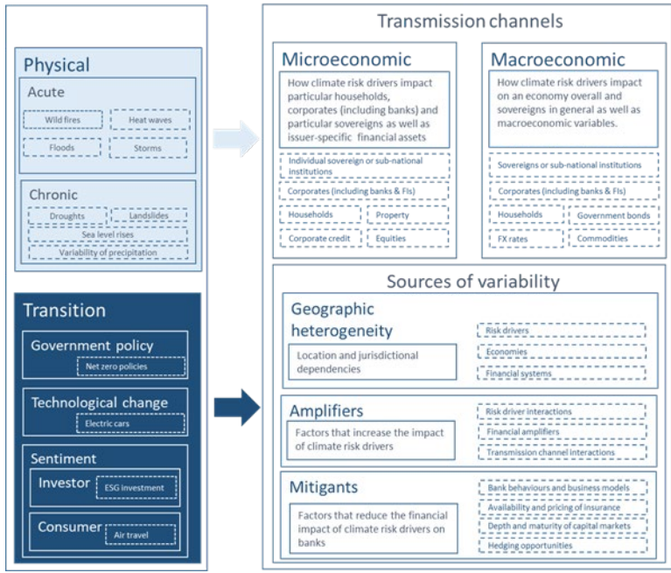
Transmission to economy-wide impacts
Source: Adapted from BIS April 2021

Slide 21
To be added
More knowledge on measurement and existing data

Slide 22
III. Integrating climate risks into fiscal risk assessment

Slide 23
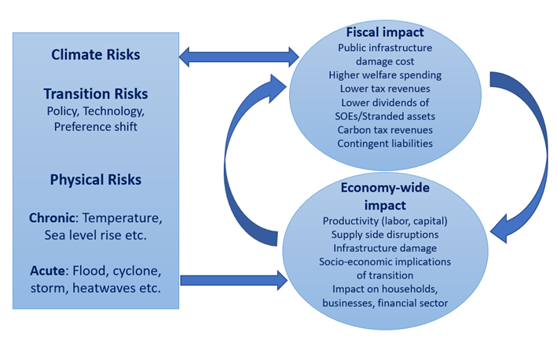
Fiscal impact channels from climate risks
Source: WBG Staff adaptation from Dunz and Power (2021).

Slide 24
Dashboard of indicators on dimensions of vulnerability
Identify broad risk categories
Measure these with proxy indicators of how those risk categories relate to fiscal aggregates.
Expand to include:
  Compound risks
  Cascading risks
  Global transition spill-over risks
  Domestic transition risks.
Build on IMF’s Systemic Risk Tracker

Slide 25
IV. Identifying fiscal policy tools to address fiscal risks stemming from climate change
Based on key risks identified at the country level, what policy options would be most impactful in mitigating fiscal risks?
Budget preparation: include climate-related fiscal risks as part of the Budget Call Circular, and ask line ministries to justify their budget requests based on that risk identification.
Other

Slide 26
Next steps

Slide 27
Thank you

Slide 28
Annexe 1: Analogy with Financial Risk

Slide 29
Risk: Financial Example
We compose risk into four components: hazard, exposure, sensitivity, and coping capacity.
To use a financial example, Risk can be composed into
  Hazard to a bank might be the potential 95% worst-case move of long term USD interest rates,
  Exposure might be the value of US gov bonds held
  Sensitivity is the change of value of the bonds to the interest rate
  Overall coping capacity might be the capital buffer of the bank.
Risk | Hazard | Exposure | Sensitivity | General Coping Capacity
Risk bank goes bankrupt measured by credit rating of the bank | Hazard 1 (Market Risk) Change in USD long term interest rates (r, %) | USD gov bonds held ($m) | Raw sensitivity Change in value per 1% change in r per $ exposure | Capital buffer ($m)

Slide 30
Risk: Financial Example
There can also be specific coping strategies for example insurance, hedges or adaptation
Risk | Hazard | Exposure | Sensitivity | General Coping Capacity
Risk bank goes bankrupt measured by credit rating of the bank | Hazard 1 (Market Risk) Change in USD long term interest rates (r, %) | USD gov bonds held ($m) | Raw sensitivity Change in value per 1% change in r per $ exposure | Capital buffer ($m)
 |  | Hedge / Insurance held ($m) | Sensitivity modification given specific coping strategy: Insurance/adaptation – Change in value per 1% change in r

Slide 31
Value at Risk
Value at Risk (VAR) at a particular probability scenario over timescale (1 year) includes hazard , exposure and sensitivity. In a linear situation (rare):
VAR_{95%} = Move_{95%} * Exposure * Sensitivity
Value at Risk measures the overall risk level as a product of Hazard, Exposure and Sensitivity
Risk | Hazard | Exposure | Sensitivity | Coping Capacity (General)
Risk bank goes bankrupt measured by credit rating of the bank | Hazard 1 (Market Risk) Change in USD long term interest rates (r, %) | Channel 1: USD gov bonds held ($m) | Change in value per 1% change in r per $ exposure | Capital buffer ($m)

Slide 32
Different Hazards and Channels
Risk | Hazard | Exposure | Sensitivity | Coping Capacity (General)
Risk bank goes bankrupt measured by credit rating of the bank | Hazard 1 (Market Risk) Change in USD long term interest rates (r, %) | Channel 1: USD gov bonds held ($m) | Change in value per 1% change in r per $ exposure | Capital buffer ($m)
 |  | Channel 2: USD corporate bonds held ($m) | Change in value per 1% change in r per $ exposure
 | Hazard 2: (Credit Risk) Risk of higher default rate on loans | Channel 3: Loans Outstanding ($m) | Loss given default (LGD)
 |  | Specific Insurance (Credit default swaps) | Payout given reference event
Different Hazards (for example, market risk of interest rate changes and credit risk of defaults)
Different Exposure Channels for given hazard (for example exposure of government and corporate bonds)
Also possible: specific insurance (hedges)

Slide 33
Annexe 2

Slide 34
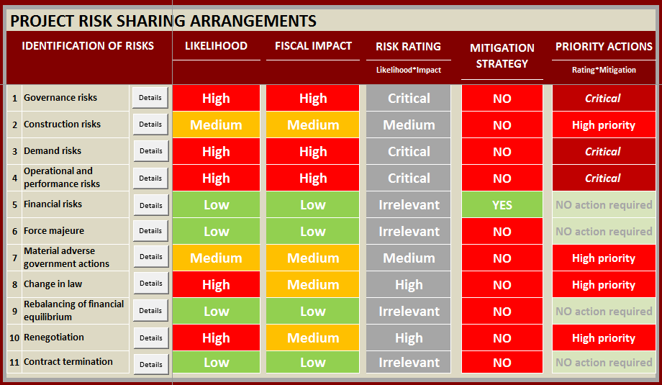
PFRAM “Heat map”
Assesses fiscal risks from PPP projects
PROJECT A - Example

Slide 35
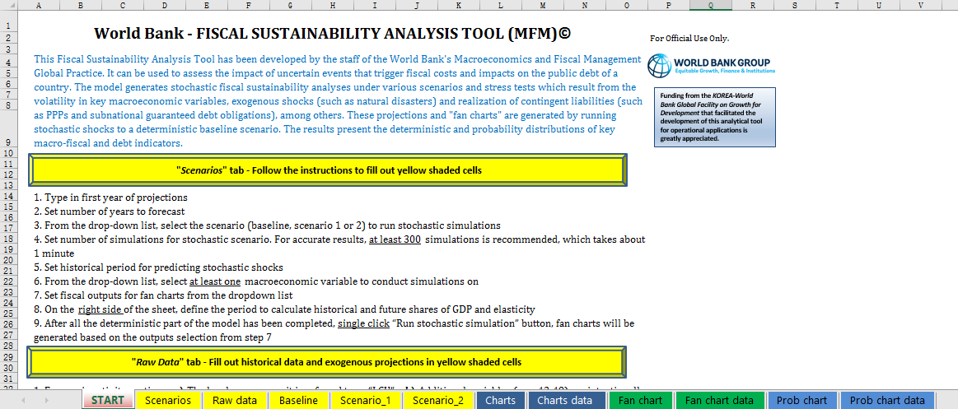
The Excel-based Fiscal Sustainability Analysis Tool

Slide 36
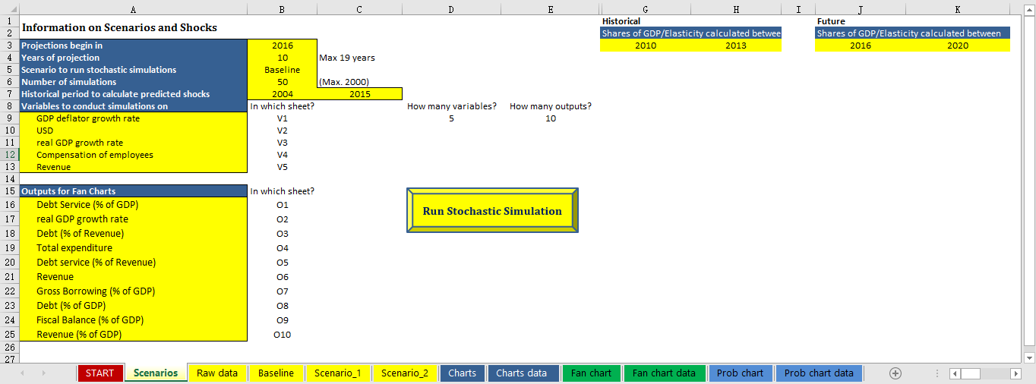
The Excel-based Fiscal Sustainability Analysis Tool

Slide 37
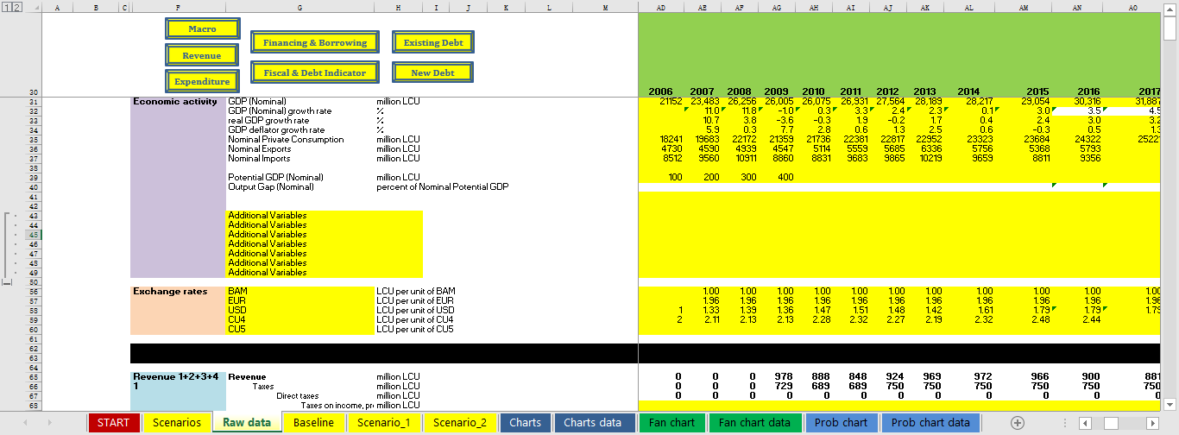
The Excel-based Fiscal Sustainability Analysis Tool

Slide 38
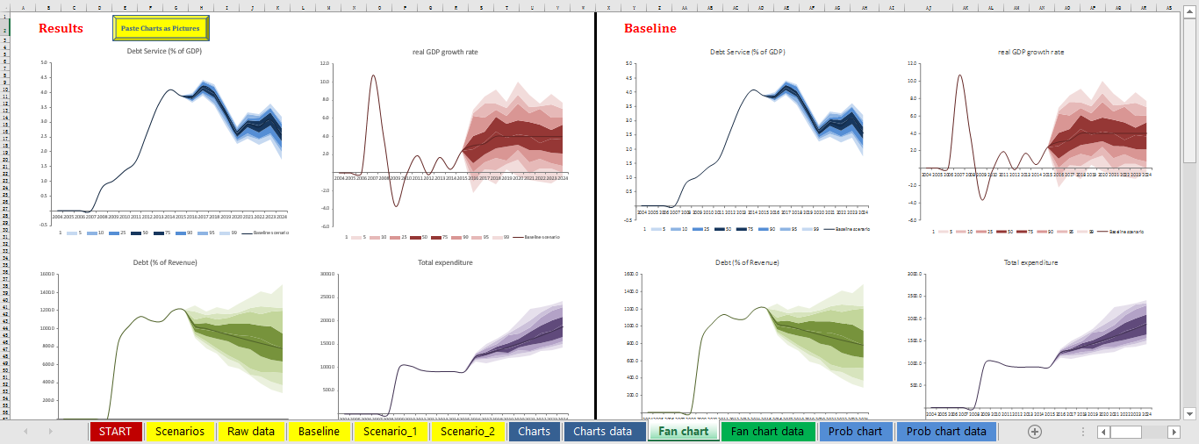
The Excel-based Fiscal Sustainability Analysis Tool
Scenarios and Stress Tests Under Uncertainty (Stochastic)

Slide 39
Objective and main features
This template aims to support the country economist in preparing presentations during the PRE preparation, from identification mission to dissemination.
It includes many layouts to have a more stable layout across the presentations and prevent the user from having to change the layouts manually.
It is set so the user can copy any chart from the PFR Data Visualization Tool or created by the MTI Tool Excel add-in, preserving the formats, including colors; the user would only need to resize the fonts. <to be confirmed>

Slide 40
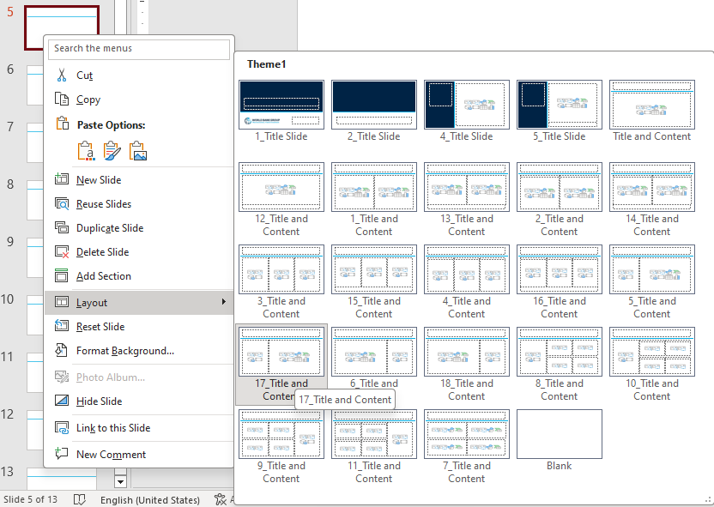
Select layouts
Use the layout option in the contextual menu (right-click) in the slides panel to select the option that better accommodates your needs.
Although the tool offers a wide variety of layers, using those with fewer objects is recommended to maximize the content (bullet points, charts, images, diagrams) areas and the size of letters.
You can also find the layouts in the Slides section in the Home menu of PowerPoint.

Slide 41
Copy Excel charts
Copy the chart from Excel to any of the predefined boxes in the selected layout.
The chart size will automatically adjust to the size of the box.
Adjust the font size to make the chart more readable.
Adjust other elements as you this is convenient.

Slide 42
Some layouts have boxes for titles and notes
Gini coefficient before and after taxes and transfers
0-100 (the worst)
Correlation between real GDP and public spending cyclical components
-1 to 1 (the highest cyclicality)
Source: World Bank Staff’s estimates and Standardized World Income Inequality Database.

Slide 43
The template uses the same formatting criteria than the Word and Excel templates
The three templates have consistent layouts
They use the same fonts: Aptos for titles and Aptos light for other content
They use the same color theme
R 0 G 0 B 0 | R 250 G 250 B 250 | R 0 G 35 B 69 | R 200 G 200 B 200 | R 0 G 173 B 228 | R 240 G 80 B 35
R 0 G 156 B 167 | R 253 G 183 B 20 | R 0 G 171 B 81 | R 235 G 28 B 45 | R 0 G 168 B 150 | R 135 G 43 B 143

Slide 44

Use the blank layout to be more creative

Slide 45
Thanks!

